Slide 1

STUDY OF THE IMPACT OF NON-DETERMINISM ON NUMERICAL REPRODUCIBILITY AND DEBUGGING AT THE EXASCALE
Dylan Chapp
Advisor: Dr. Michela Taufer Committee Members: Dr. Michela Taufer, Dr. Sunita Chandrasekaran

Slide 2
Acknowledgements
I want to thank my advisor, Dr. Michela Taufer, my mentors at LLNL Kento Sato and Dong H. Ahn, my committee member Dr. Sunita Chandrasekaran, my co-author Dr. Travis Johnston, and finally all of the GCLab members for their company and support.

Slide 3
Thesis Statement
Impending increase in concurrency of HPC systems will amplify:
Numerical irreproducibility
Impeded debugging
We address the numerical challenge by demonstrating the need for runtime selection of reduction operators for problematic floating-point inputs
We address the debugging challenge by demonstrating the need for improved logical clock ticking policies for the Clock-Delta Compression record-and-replay technique

Slide 4
Non-Determinism in HPC Applications
HPC applications exhibit non-determinism
e.g., overlapping communication and computation
Non-determinism can be internal or external
Internal: Internal states varies from run to run
External: Numerical outputs observed to vary
Challenges:
In a numerical scenarios, control variability thresholds (error) in computational results
In a debugging scenarios, control the non-deterministic interactions among processes/threads
Notes:
Let's clarify what we mean by non-determinism
What does it mean in terms of numerical/scientific output?
What does it mean in terms of application behavior?

Slide 5
The Exascale Environment

Slide 6
The Numerical Challenge
Impending increase in concurrency of HPC systems will amplify:
Numerical irreproducibility
Impeded debugging
We address the numerical challenge by demonstrating the need for runtime selection of reduction operators for problematic floating-point inputs
We address the debugging challenge by demonstrating the need for improved logical clock ticking policies for the Clock-Delta Compression record-and-replay technique

Slide 7
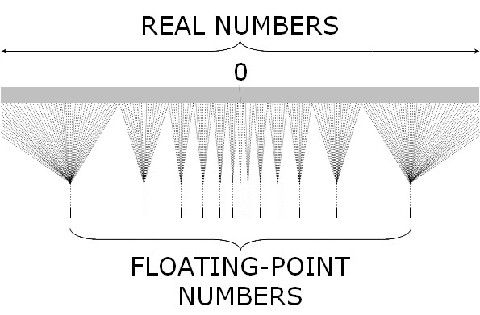
The Numerical Challenge
The modeling of finite-precision arithmetic maps an infinite set of real numbers onto a finite set of machine numbers
http://cs.smith.edu/dftwiki/index.php/CSC231 An Introduction to Fixed- and Floating-Point Numbers
Notes:
If non-determinism is one half of the numerical challenge, the other half is the intrinsic properties of floating-point numbers

Slide 8
Simple Example
?
?
Notes:
These two sums should be equal right?
They would if FP addition was associative, but…
Specifically, FP addition is non-associative

Slide 9
Simple Example
Notes:
Next 2 slides shows 2 different ways this kind of variability in ordering can manifest

Slide 10
Non-Determinism at Extreme Scale
Reduction tree shape
s₂
s₁
s₂
s₁
(
)
(
)
exact sum
error bounds
exact sum
Causes include: dynamic task scheduling and fault recovery
Notes:
For rest of talk we will use term "reduction tree" to talk
about order in which operands are reduced / partial sums are formed
Variability in reduction tree shape → e.g., due to nodes failing and
part of the computation being migrated as new resources
come back online

Slide 11
Non-Determinism at Extreme Scale
Arrangement of operands
s₂
s₁
s₂
s₁
(
)
(
)
exact sum
error bounds
exact sum
Causes include: dynamic task scheduling and fault recovery
Notes:
Even if reduction tree shape / topology is fixed, different threads might be responsible for different parts of the problem across multiple executions

Slide 12
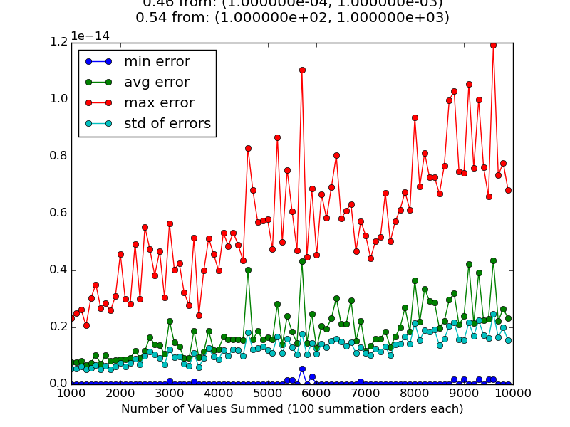
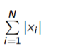
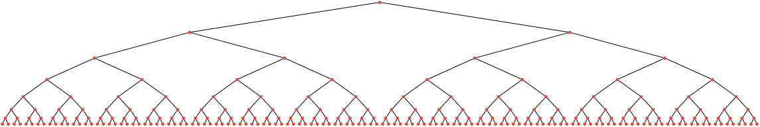
Non-Associativity + Non-Determinism
No control on the way N floating-point numbers are assigned to N threads
Error Magnitude
x0 x1 x2 x3 x4 x5 x6 x7 x8 x9 x10 x11 x12 x13 x14 x15
Different thread orders cause round-off errors to accumulate in different ways, leading to different summation results
Number of Operands
Increasing concurrency
==
Widening interval of possible sums
Notes:
The situation we’re likely to face AT EXASCALE is that NON-ASSOCIATIVITY and NON-DETERMINISM will INTERACT
CONSEQUENCE → errors are not only larger, but more variable between executions → undermines trust in scientific conclusions of simulations
HOW DO WE FIX THIS?
Error type is absolute error since exact value of sum is zero
Emphasize increase in concurrency → increase in error variability AND error size

Slide 13
Techniques for Recovering Reproducibility
Fixed reduction order
Ensuring that all floating-point operations are evaluated in the same order from run to run
Increased precision numerical types
Mixed precision - e.g. use higher-precision types for sensitive computations and standard types for less sensitive computations
Interval arithmetic
Replace floating-point types with custom types representing finite-length intervals of real numbers
Enhanced Summation Algorithms
Compensated summation e.g., Kahan and composite precision
Pre-rounded reproducible summation
Notes:
DO NOT EXPLAIN WHY FIRST THREE ARE BAD HERE
THAT’S FOR NEXT SLIDE

Slide 14
Techniques for Recovering Reproducibility
Fixed reduction order
Ensuring that all floating-point operations are evaluated in the same order from run to run
Increased precision numerical types
Mixed precision - e.g. use higher precision types for sensitive computations and standard types for less sensitive computations
Interval arithmetic
Replace floating-point types with custom types representing finite-length intervals of real numbers
Enhanced summation algorithms
Compensated summation e.g., Kahan and composite precision
Pre-rounded summation
TOO COSTLY!!!
Notes:
Fixing reduction order → reduces applications’ freedom to overlap comm. and comp.
Increased precision AND interval arithmetic → slower computations, increased communication cost since payloads get bigger (COMM >>>> COMP)
Enhanced summation algorithms → best option in a bad situation (form the basis of higher level numerical routines)

Slide 15
Standard Summation: Definition

Slide 16
Kahan Summation: Definition
Holds error
Capture error & add to operand
on next iteration
Kahan “Further Remarks on Reducing Truncation Errors” (1964)
Notes:
Pronounced: KAY-HAN
Apply correction to sum at each iteration

Slide 17
Composite Precision: Definition
Value or result
Error approximation
Error carried
through each
operation
Taufer et al.” Improving Numerical Reproducibility and Stability in Large-Scale Numerical Simulations on GPUs” (2010)
Notes:
DIFFERENCE FROM KAHAN
Build up a correction term over whole loop, add it back at end
RATIONALE: small correction terms might get swallowed by big partial sum, this gives the correction a chance to grow large enough to matter

Slide 18
Pre-rounded Summation
v1 + v2:
Until error < threshold
select extractor M
q1 = (v1 + M) – M
q2 = (v2 + M) – M
q1 + q2
r1 = v1 – q1
r2 = v2 – q2
Demmel and Nguyen “Parallel Reproducible Summation” (2014)
Arteaga, Hoefler et al. “Designing Bit-Reproducible
Portable High-Performance Applications” (2014)
18
18
Notes:
Unlike others → GUARANTEED BITWISE REPRO.
Pre-round, then recurse onto rounded-off parts
DON’T MENTION COST YET… NEXT SLIDE

Slide 19
Pre-rounded Summation
2-fold pre-rounding versions and varying vector sizes
~7x
~4x
Intel MKL library
Demmel and Nguyen “Parallel Reproducible Summation” (2013)
Notes:
Despite offering “tunable” cost in terms of number of pre-rounded phases, the whole thing is still fairly costly
MAIN POINT:
If you absolutely need perfect bitwise repro and are willing to pay for it, pre-rounding offers it
If you just need PROBABLY SMALL variability between runs, SOME form of compensated summation is the way to go
Our contribution is an evaluation of compensated summation techniques for “DIFFICULT” FP inputs

Slide 20
Empirical Study: Global Reduction
Emulate sums expected in exascale simulations
Shuffling summation order emulates nondeterministic reduction tree
Measure sensitivity of summation algorithms to:
Changes in summation order
Mathematical properties of summands
Interpret width of result interval as sensitivity
Test summation algorithms: Standard (ST), Kahan (K), Composite-precision (CP)
D. Chapp, T. Johnston, and M. Taufer. “The Strong Case for Pursuing Numerical Reproducibility through Intelligent Runtime Selection of Reduction Algorithms at
the Extreme Scale.” In Proceedings of IEEE Cluster Conference (2015)
Notes:
We have some choices for *better* but not bitwise reproducible summation algorithms
How do we evaluate their performance against difficult FP problems?

Slide 21
Emulating Exascale Scenarios
Real Numbers
x₀
x₁
x₂
x₃
x₄
x₅
0
Floating-point
Numbers
f(x₀)
f(x₁)
f(x₂)
f(x₃)
f(x₄)
f(x₅)
Non-determinism at exascale
==
shuffled summation order
Roundoff errors
accumulate
{s_{j} == sum wrt j^{th} summation order}
s₁
s₀
s₂
s₃
s₄
{s_{j}}
Notes:
Top half --> representation error from converting to FP
Middle --> randomized summation order to simulate exascale scenario

Slide 22
Emulating Exascale Scenarios
Real Numbers
x₀
x₁
x₂
x₃
x₄
x₅
0
Floating-point
Numbers
f(x₀)
f(x₁)
f(x₂)
f(x₃)
f(x₄)
f(x₅)
Non-determinism at exascale
==
shuffled summation order
Roundoff errors
accumulate
width of interval
∝
irreproducibility
{s_{j} == sum wrt j^{th} summation order}
s₁
s₀
s₂
s₃
s₄
{s_{j}}
Notes:
Bottom half --> Each summation order (from middle) yields a slightly different sum
The width of interval in which these sums lie is our metric for how irreproducible the problem is, under a given form of summation
…
Now that we’ve described our general framework, let’s move on to how we characterize the input (i.e., the set of summands)

Slide 23
Characterizing Sets of Summands
Notes:
We start with the formula for relative error of a sum of floating-point values
What are the FACTORS that make a floating-point sum susceptible to:
Error
Variability under different summation orders

Slide 24
Characterizing Sets of Summands
Critical Parameters
Size: n
Condition number: k
Dynamic range: dr
Notes:
Last term literally IS the def. of condition number
Dynamic range is difference between largest and smallest exponent of the FP numbers

Slide 25
Characterizing Sets of Summands
Critical Parameters
Size: n
Condition number: k
Dynamic range: dr
Proxy for…
Concurrency
Subtractive cancellation
Alignment error
Notes:
Audience confused → wanted visual representations of subtractive cancellation and alignment error

Slide 26
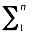
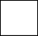


Summation algorithm selection
Given an variability threshold (error), which algorithm is needed
{x1, x2, …. xn}
Values
S_{σ} = x_{σ(i)} σ – perm. of [n]
Sum of
shuffled values
{S_{σ_1} ,S_{σ_2} ,S_{σ_3} ….. S_{σ_100} }
Multiple sums
of multiple
permutations
k
{ε_{σ_1} , ε_{σ_2} , ε_{σ_3} ….. ε_{σ_100} }
Errors w/r/t
GNU MPFR
result
…..
error variability
Error
variability
dr
Cell shade == algorithm keeps variability below threshold
ST
K
CP
Notes:
We consider a parameter space where
k ranges from 0 to 1M (larger is worse)
dr ranges from 0 to 32 (larger is worse)
For each cell we compute the sum of the values in 100 different shuffled orders using each summation algorithm → simulate non-determinism on exascale platforms
Variability of error with respect to a known “exact” sum is our metric for “how reproducible”
Color each cell based on the “least expensive / complex” summation that keeps the error variability below a given threshold

Slide 27

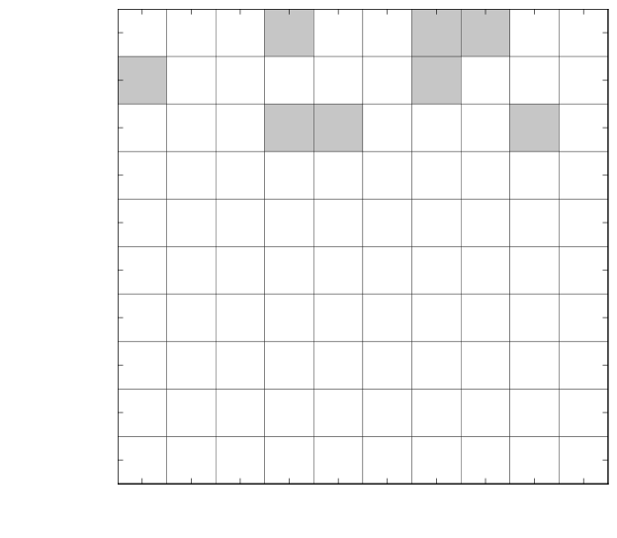
Selecting a Sufficient Algorithm
ST
K
CP
Variability threshold = 5e-13
High
Medium
Low
Notes:
Variability threshold seems REALLY small. Mention applications (e.g., mathematical physics) that need such low variability

Slide 28
Selecting a Sufficient Algorithm
ST
K
CP
Variability threshold = 3.5e-13
High
Medium
Low
28

Slide 29
Selecting a Sufficient Algorithm
ST
K
CP
Variability threshold = 3e-13
High
Medium
Low
29

Slide 30
Selecting a Sufficient Algorithm
ST
K
CP
Variability threshold = 2.5e-13
High
Medium
Low
30

Slide 31
Selecting a Sufficient Algorithm
ST
K
CP
Variability threshold = 1.5e-13
High
Medium
Low
31

Slide 32
Selecting a Sufficient Algorithm
ST
K
CP
Variability threshold = 2.5e-14
High
Medium
Low
32

Slide 33
Lessons Learned
Non-determinism impacts reproducible accuracy of global summation on exascale platforms
Exascale applications need to maintain awareness of mathematical properties of summands
Runtime selection of reduction operators can help tune the tradeoff between reproducibility, accuracy, and performance

Slide 34
The Debugging Challenge
Impending increase in concurrency of HPC systems will amplify:
Numerical irreproducibility
Impeded debugging
We address the numerical challenge by demonstrating the need for runtime selection of reduction operators for problematic floating-point inputs
We address the debugging challenge by demonstrating the need for improved logical clock ticking policies for the Clock-Delta Compression record-and-replay technique
Notes:
Now we move on to the second challenge—namely that non-determinism in HPC applications impedes debugging

Slide 35
Non-Determinism in Message Passing Applications
P₀
Execution 1
P₁
…
P_{N}
P₀
P₁
Execution 2
…
P_{N}
Same destinations Different ordering
Different destinations
Notes:
This shows a relatively common scenario in message passing HPC applications
Message receive order in a receiving process can vary from run to run
But what are the consequences?

Slide 36
Impact on Debugging
Case Study: A non-deterministic bug in Diablo/HYPRE
Application hung several hours in, in approximately 1/50 runs
Cost of debugging effort:
18 months
9560 node-hours
Kento Sato, Dong H. Ahn, Ignacio Laguna, Gregory L. Lee, Martin Schulz and Christopher M. Chambreau, “Noise Injection Techniques for Reproducing Subtle and Unintended Message Races”, Proceedings of the 20th ACM SIGPLAN Symposium on Principles and Practice of Parallel Programming (PPoPP17), Austin, USA, Feb, 2017.
Notes:
The consequences can be be fairly severe!
How do we address this situation?

Slide 37
Impact on Debugging
Case Study: A non-deterministic bug in Diablo/HYPRE
Application hung several hours in, in approximately 1/50 runs
Cost of debugging effort:
18 months
9560 node-hours
Bug not solved until a record-and-replay tool was deployed
Bug was due to unintended message race that the tool was able to record and replay deterministically
Kento Sato, Dong H. Ahn, Ignacio Laguna, Gregory L. Lee, Martin Schulz and Christopher M. Chambreau, “Noise Injection Techniques for Reproducing Subtle and Unintended Message Races”, Proceedings of the 20th ACM SIGPLAN Symposium on Principles and Practice of Parallel Programming (PPoPP17), Austin, USA, Feb, 2017.
Notes:
The consequences can be be fairly severe!
How do we address this situation?
ANSWER → Record and replay tools

Slide 38
Record and Replay as General Solution
P₀
Recorded Execution
P₁
…
P_{N}
Observe and record message-matching events
Record Mode
Persist record of events to storage
Read record and control replayed execution
Replay Mode
P₀
Replayed execution is only allowed to proceed as the record dictates
Replayed Execution
P₁
…
P_{N}
Notes:
Feedback:
The record/replay tool is depicted here as a single red line, but it’s important to remember that--in the case of ReMPI--for each application process there are 3 ReMPI threads:
A thread that executes the code that wraps the MPI function calls
A thread that asynchronously records or replays
A thread for IO to/from the record file for this process

Slide 39
Clock Delta Compression (CDC)
Record format consists of 3 parts:
Matched-test table
Unmatched-test-table
With-next-table
Compression pipeline has 3 stages
Redundancy elimination (splitting base record into tables)
Permutation encoding
Linear Predictive Encoding (LPE) + GZIP
Notes:
CDC builds up a “record format” for each process → we focus on matched-test table because it is the target of the novel compression technique AND the most amenable to further reduction in size
CDC compresses each process’s record format with the compression pipeline
Biggest compression comes from permutation encoding
Permutation encoding depends on CDC’s use of logical clocks

Slide 40
Clock Delta Compression (CDC)
Record format consists of 3 parts:
Matched-test table
Unmatched-test-table
With-next-table
Compression pipeline has 3 stages
Redundancy elimination (splitting base record into tables)
Permutation encoding
Linear Predictive Encoding (LPE) + GZIP
Orders events by attaching logical clocks on messages
Messages received by a process are either in-order or out-of-order
CDC record size depends on number of out-of-order messages
Notes:
CDC builds up a “record format” for each process → we focus on matched-test table because it is the target of the novel compression technique AND the most amenable to further reduction in size
CDC compresses each process’s record format with the compression pipeline
Biggest compression comes from permutation encoding
Permutation encoding depends on CDC’s use of logical clocks
Easier to explain with a walked through concrete example (For sake of time)
Concrete example will show what we mean by attaching logical clocks to messages, in-order vs. out-of-order, AND we will demonstrate the claim that CDC record size depends on number of out-of-order messages

Slide 41
Logical Clocks
Each process maintains a “local clock” (LC)
Each message has the sender’s LC attached as “sent clock” (SC)
LC = 16
LC = 18
P₁
Sent clock (SC)
17
LC = 17
LC = 18
P₀
Notes:
This establishes ordering of events within process and between processes
On SEND → attach then “tick”
On RECV → max(LC, SC) then “tick”

Slide 42
In-Order vs. Out-of-Order Messages
In-Order Message Receive
Out-of-Order Message Receive
Notes:
CDC makes each process classify messages it receives as in-order or out-of-order
Depends on SCs of previously received messages

Slide 43
Recording Walkthrough
Notes:
Process 0 has a ”local clock” LC that starts at 0
This is a demonstration of Lamport ticking

Slide 44
Recording Walkthrough
Notes:
This is a demonstration of Lamport updating
Accept without proof that it is sufficient for replay to record only message receive events (technically message receive completions) because sends will happen in same order from run to run AND they have a fixed destination, unlike receives, which can use wildcard for source parameter
Notice too that process 0 has started to keep track of the sent clocks (SC) it has received

Slide 45
Recording Walkthrough
Notes:
Notice that as process 0 receives more messages, it receives more SCs and builds up a history of SCs
These receives are so far, IN-ORDER == received SC history is monotone increasing

Slide 46
Recording Walkthrough
Notes:
Now we do some more lamport ticking on sends

Slide 47
Recording Walkthrough
Notes:
Now process 0 receives an OUT-OF-ORDER message
Monotonicity broken
We will have to record this explicitly eventually…

Slide 48
Recording Walkthrough
Notes:
This is our final stage → the execution is done and it’s time to compress our record of message-receive events

Slide 49
Permutation Encoding

Slide 50
Recovering the Observed Order during Replay
Notes:
Explain how replay works, then say:
Now that we’ve established that out of order messages are what we want to avoid,
How do we do that? Out-of-order messages are a consequence of a process receiving a particular set of sent clocks
That particular set of sent clocks has values that come from how the clocks in the sending processes “ticked”

Slide 51
Logical Clock Ticking Policies
A rule for determining what value the ticks should have
Ticking policy influences out-of-order messages, hence influences record size
We consider three kinds:
Notes:
So far, we’ve assumed that ”ticks” are always 1

Slide 52
Logical Clock Ticking Policies
A rule for determining what value the ticks should have
Ticking policy influences out-of-order messages, hence influences record size
We consider three kinds:
“Basic” --> Tick always equals 1
Notes:
Basic ticking is what we’ve shown so far
Number of MPI_Send calls is essentially a proxy for process progress /time

Slide 53
Logical Clock Ticking Policies
A rule for determining what value the ticks should have
Ticking policy influences out-of-order messages, hence influences record size
We consider three kinds:
“Basic” --> Tick always equals 1
“Wall-time” --> Tick is based on MPI_Wtime value
Notes:
Empirical evidence shows that in some cases, ticking based on wall-time can lower the rate of out-of-order messages,
i.e., wall time represents process progress better than # MPI_Send calls

Slide 54
Logical Clock Ticking Policies
A rule for determining what value the ticks should have
Ticking policy influences out-of-order messages, hence influences record size
We consider three kinds:
“Basic” --> Tick always equals 1
“Wall-time” --> Tick is based on MPI_Wtime value
“FLOPs” --> Tick is based on PAPI_FP_INS counter value
Notes:
But wall-time has issues during replay since processes’ physical clocks do not tick exactly the same way during recording and replay
But we think that #FLOPs is likely:
A good approximate of wall time
Empirically shown to be replayable

Slide 55
Logical Clock Ticking Policies
P₀
P₀
P₀
w₁ sec.
f₁ FLOPs
w₂ sec.
3
w₁
f₁
f₂ FLOPs
f₂
5
w₂
3 < 5 in-order
w₁ < w₂ in-order
f₁ < f₂ in-order
Basic Ticking
Wall-time-based Ticking
FLOPs-based Ticking

Slide 56
Evaluating Ticking Policies
Goal: evaluate FLOPs-ticking’s effect on out-of-order messages when used by a real record-and-replay tool on a real application
Application:
Monte-Carlo Benchmark (MCB)
Domain-decomposed particle simulation
Known to be non-deterministic
Record-and-Replay Tool:
Reproducible MPI (ReMPI)
Implements CDC

Slide 57
Three Communication Patterns in MCB
Neighbor-to-neighbor particle exchange
Non-blocking Gather
Non-blocking Scatter
p₀
p₀
p₀
p₁
p₂
p₁
p₂
p₁
p₂
p₃
p₄
p₅
p₃
p₄
p₅
p₆
p₃
p₄
p₅
p₆
p₆
p₇
p₈
p₇
p₈
p₇
p₈

Slide 58
ReMPI Record and Replay MPI Framework
Record MPI message orders so they can be deterministically replayed exactly later
Provide scalable order-replay
Store compressed representation of differences between observed communication and logical clock reference orders
Run #1: Record
App Starts
App Finish
CDC Compression
Compressed record
MPI comm. event
run1.out == run2.out
Run #2: Replay
App Starts
Query ReMPI record
App Finish
Kento Sato, Dong H. Ahn, Ignacio Laguna, Gregory L. Lee, and Martin Schulz, “Clock Delta Compression for Scalable Order-Replay of Non-Deterministic Parallel Applications”, Proceedings of SC15, Austin, USA, Nov, 2015.
Notes:
ReMPI compression pipeline
Clock Delta Compression (CDC) + Linear predictive encoding (LPE) + GZIP
Clock Delta Compression → Stores diff between observed order and reference order, instead of explicitly storing the whole observed order
Linear predictive encoding → A lossless transformation that makes the CDC record more amenable to GZIP
Goal: improving the compression of the matched-test table
Our approach is to make the diff between observed and reference order smaller with fine-grained logical clock ticking based on performance counters

Slide 59
Experiment Procedure
For each ticking policy:
Do 100 runs of MCB, logging total # messages received and # messages received out-of-order for each process
Count how many processes across all runs received a given percentage of messages out-of-order
Compare ticking policies based on their distributions of percentages
Notes:
Rationale → out-of-order message percentage strongly correlates with matched test table size AND isn’t muddled by further compression steps
i.e., if we see an improvement, we know it was due to the ticking policy, not something farther down the pipeline
We’re going to present data in the form of “out-of-order histograms”

Slide 60
Interpreting Out-of-Order Histograms
~60 MPI processes had 30% of total messages received out-of-order

Slide 61
Interpreting Out-of-Order Histograms
WTIME ticking policy resulted in fewer out-of-order messages overall

Slide 62
Experiment Parameter Space
MCB Message Buffer Size
( Smaller == More Messages )
5
50
500
5000
1K
Tests Complete:
1-node, 16-proc.
4-node, 64-proc.
16-node, 256-proc.
=
10K
( Larger == More FLOPs )
# Particles per Subdomain
Tests In-progress:
1-node, 16-proc.
4-node, 64-proc.
16-node, 256-proc.
100K
=
1M
Notes:
Each green cell is a config of MCB
For each, we ran 3x100 executions in that config (i.e., 100 per ticking policy)

Slide 63
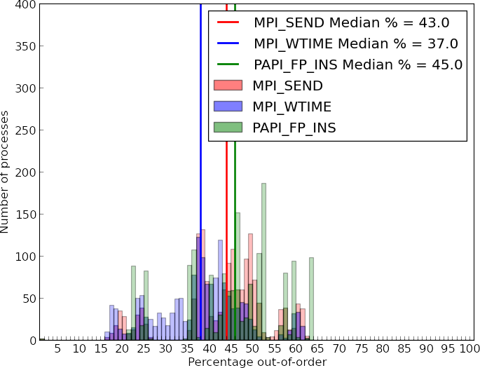
100 x 1-node, 16-proc., 10-step runs
Notes:
Low buffer size → High comm. Intensity
Low particle count → Low FP workload

Slide 64
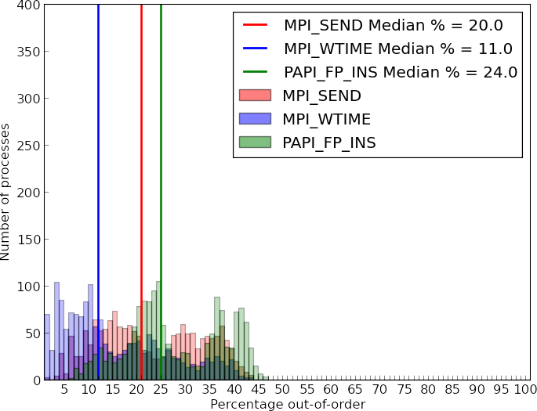
100 x 1-node, 16-proc., 10-step runs
Notes:
High buffer size → Low comm. Intensity
Low particle count → Low FP workload

Slide 65
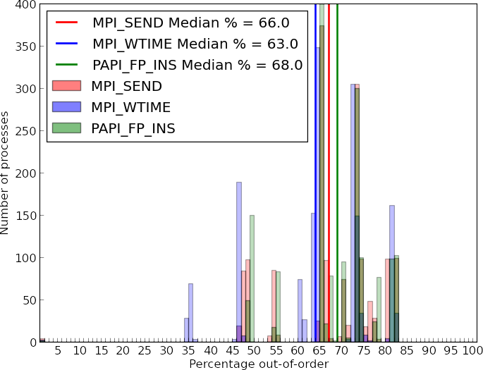
100 x 1-node, 16-proc., 10-step runs
Notes:
Low buffer size → High comm. Intensity
High particle count → High FP workload

Slide 66
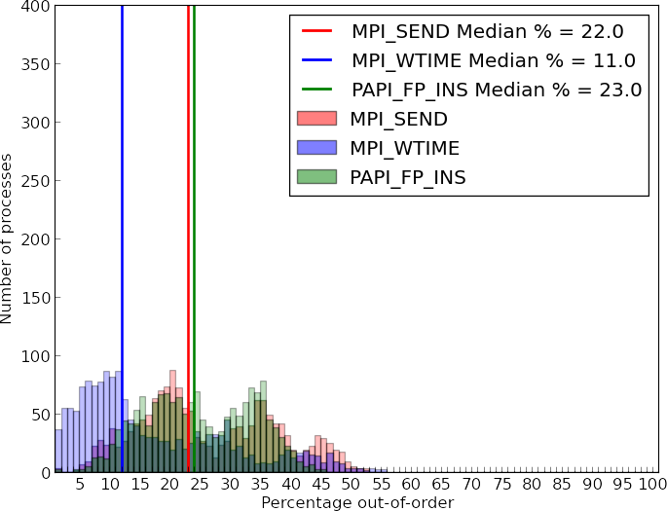
100 x 1-node, 16-proc., 10-step runs
Notes:
High buffer size → Low comm. Intensity
High particle count → High FP workload

Slide 67
100 x 1-node, 16-proc., 10-step runs
Notes:
Takeaways:
Increasing comm intensity hurts all three ticking policies → shifts distribution to the right --> more processes receiving higher % of messages out of order
Increasing FP workload seems to narrow the gap between basic ticking and FP ticking
Walltime does really well, but maybe this is because on single node, clocks are well-synchronized

Slide 68
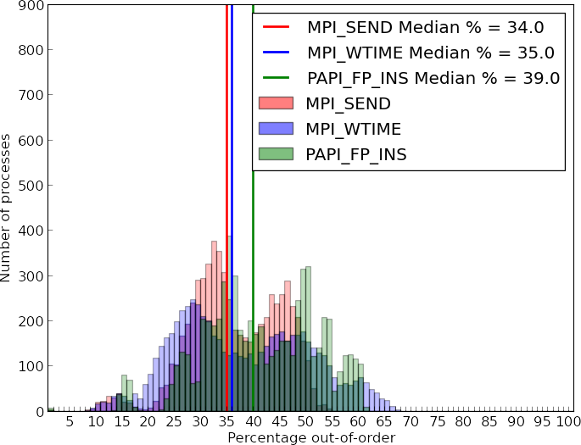
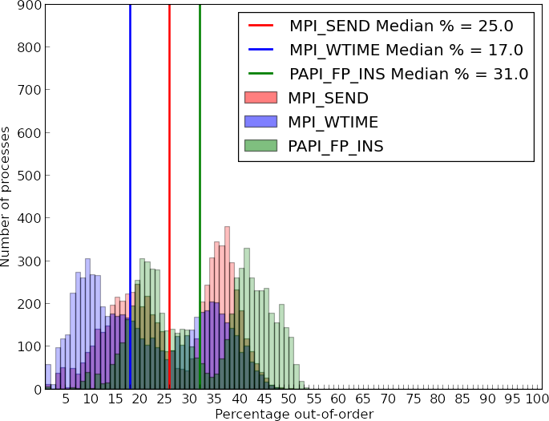
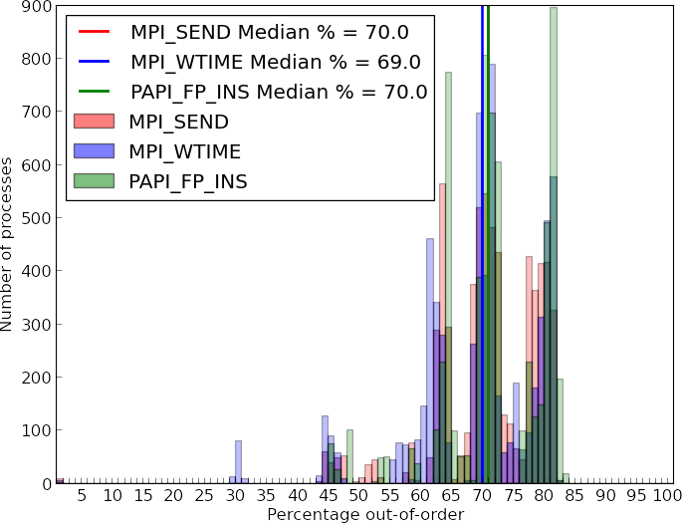
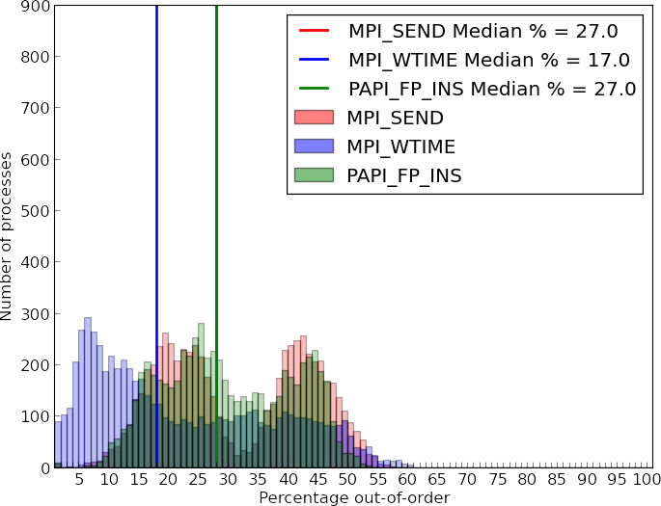
100 x 4-node, 64-proc., 10-step runs
Notes:
Takeaways:
In low comm intensity / low FP work case, we still see stratification of the ticking policies
But when comm intensity is increased, wall time’s advantage disappears → more messages means # MPI_Send calls is better representative of time
In high FP workload cases, gap between basic and FP ticking gets even narrower

Slide 69
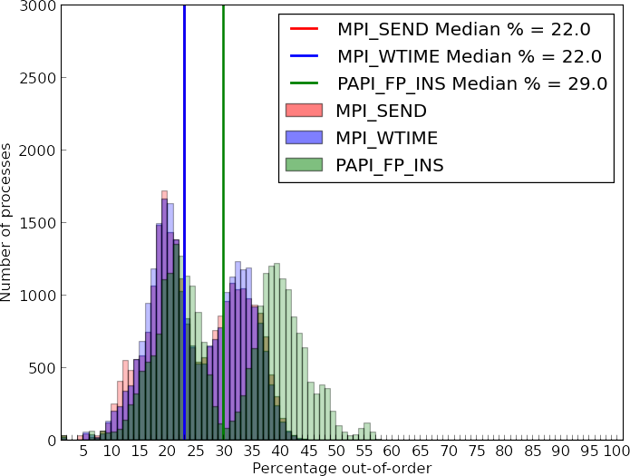
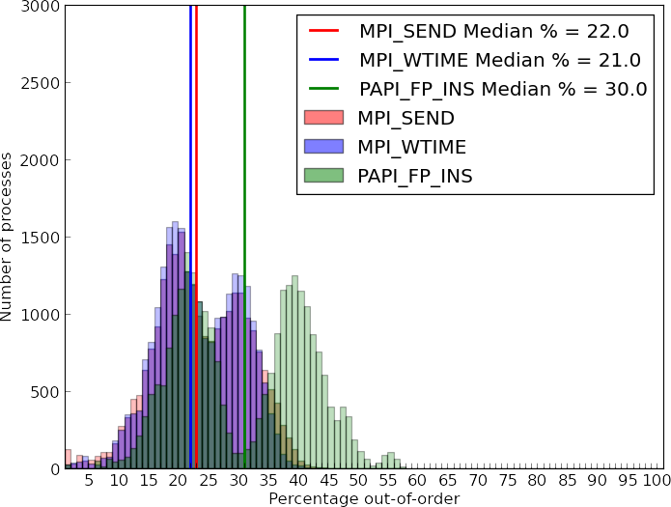
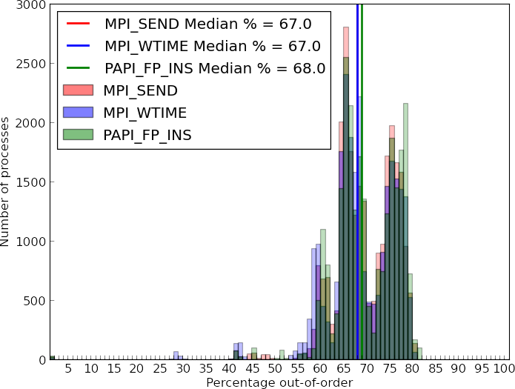
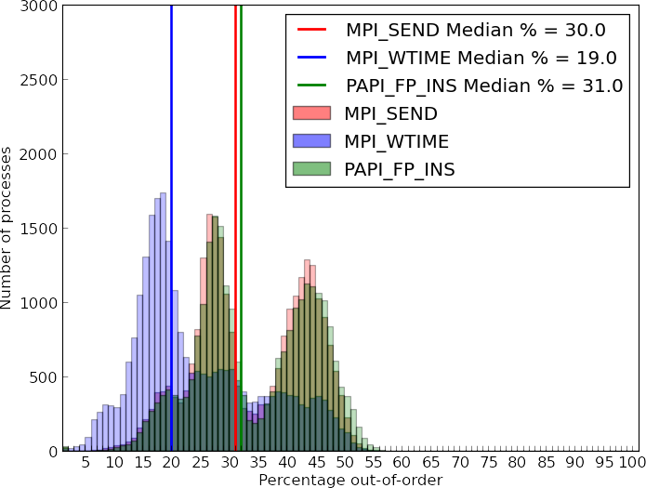
100 x 16-node, 256-proc., 10-step runs
Notes:
Takeaways:
Trends from previous experiments continue with exceptions:
Basic ticking closes the gap on walltime in the low/low case → possibly because clocks are not well synch’d across 16 nodes

Slide 70
Lessons Learned
Non-determinism impacts debugging on exascale platforms
Exascale applications need mechanisms to record and replay critical executions, while minimizing record size
FLOPs-based ticking didn’t provide the improvement to CDC we thought it would…
Notes:
Record and replay tools are going to be necessary for debugging on exascale platforms
Moreover, we can barely deploy them today due to the record size problem… which is only going to get worse (as memory and IO bandwidth per core goes down)
CDC looks like it’s going to be the basis for future record and replay tools going forward, but it needs to be enhanced, starting with the logical clock ticking policy
Where do we go from here?

Slide 71
Three Communication Patterns in MCB
Neighbor-to-neighbor particle exchange
Non-blocking Gather
Non-blocking Scatter
p₀
p₀
p₀
p₁
p₂
p₁
p₂
p₁
p₂
p₃
p₄
p₅
p₃
p₄
p₅
p₆
p₃
p₄
p₅
p₆
p₆
p₇
p₈
p₇
p₈
p₇
p₈
Which communication pattern is most-responsible for out-of-order messages? Under which conditions?
Notes:
Previously results show data from the entire MCB execution…
But we know MCB consists of well defined communication phases.
WHICH ONES ARE THE WORST IN TERMS OF OUT-OF-ORDER MESSAGES?

Slide 72
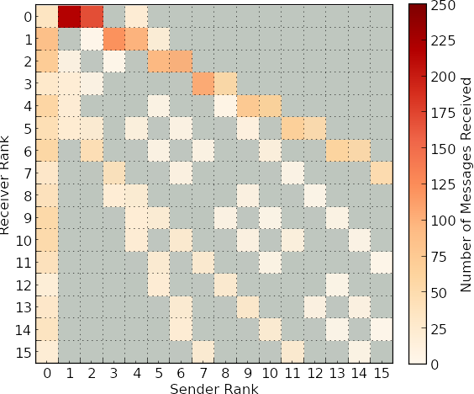
Message Receive Heatmaps
MCB Message Buffer Size
(More Messages)
5
50
500
5000
1K
10K
(More FLOPs)
# Particles per Subdomain
100K
Interpreting the Heatmap:
1M
i
= Number of messages P_{i} received from P_{j}
j
= No messages received
Notes:
We return to the parameter space from before
But zoom in on a single execution of MCB from a single configuration (i.e., the low comm.-intensity, low FP-workload case)

Slide 73
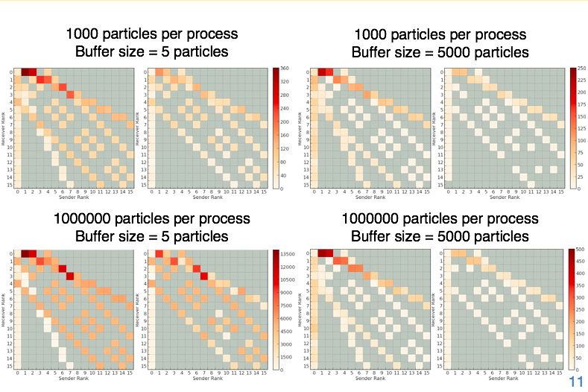
Single 1-node, 16-proc., 10-step run

Slide 74
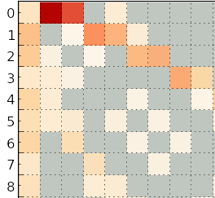
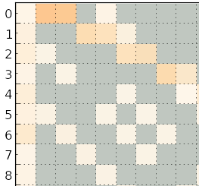
Total Receives
Communication Pattern
Out-of-order Receives
p₀
p₁
p₂
p₃
p₄
p₅
p₆
p₇
p₈

Slide 75
Total Receives
Communication Pattern
Out-of-order Receives
p₀
p₁
p₂
p₃
p₄
p₅
p₆
p₇
p₈
p₀
p₁
p₂
p₃
p₄
p₅
p₆
p₇
p₈

Slide 76
Total Receives
Communication Pattern
Out-of-order Receives
p₀
p₁
p₂
p₃
p₄
p₅
p₆
p₇
p₈
p₀
p₁
p₂
p₃
p₄
p₅
p₆
p₇
p₈
p₀
p₁
p₂
p₃
p₄
p₅
p₆
p₇
p₈
Notes:
Devising a ticking policy based on FLOPs AND on process placement AND on communication phase may provide a way forward to a more scalable CDC

Slide 77
Summary and Future Direction
Selecting from a variety of reduction operators can provide a way to tune the tradeoff between performance and reproducible numerical accuracy
A FLOPs-based ticking policy doesn’t provide improvements “out-of-the-box” but may form the basis of future adaptive ticking policies
Future work will focus on understanding non-deterministic applications in terms of their communication patterns
Notes:
We addressed the numerical challenge and found…
We addressed the debugging challenge and, despite FLOPs-ticking not being an immediate answer…
In the future, these two threads of inquiry will merge as we focus on understanding non-deterministic applications in terms of discrete communication patterns

Slide 78
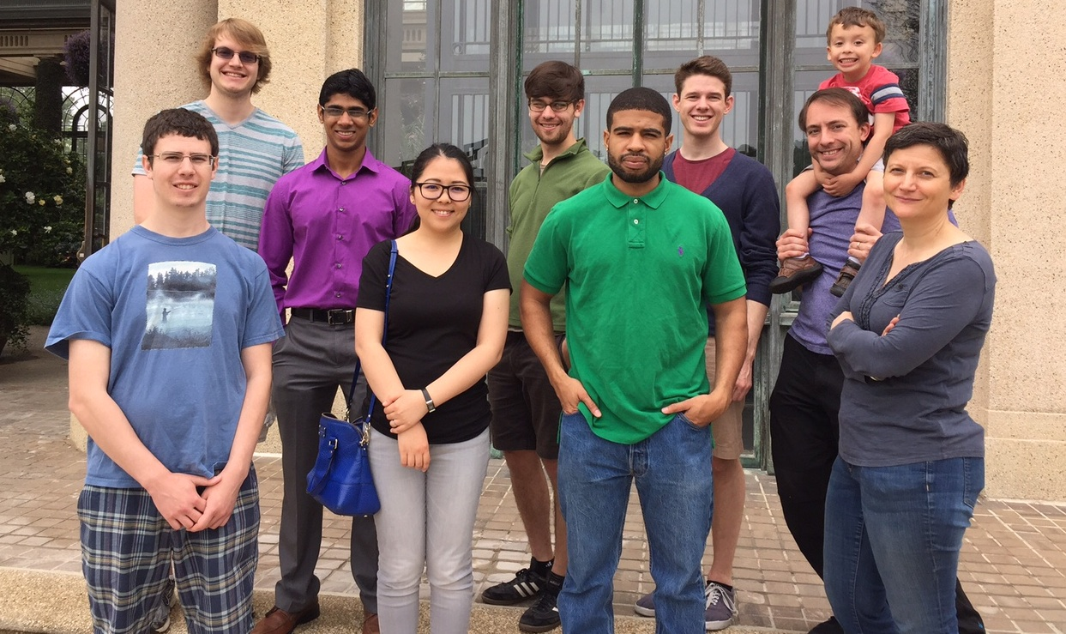



Thanks!
Global Computing Lab @ UDel

